Slide 1
Joaquin Salas Process Control Systems Engineering Intern

Slide 2

Agenda
About Me
Projects
Add Seal Pot Inst. To 730-P101A/B
RLE Compressors Cause & Effect
Install Specific Gravity and pH Meters
Radar Gauge TKs 109/115
Control Valves TKs 109/115
More Projects
Miscellaneous
Intern Experience
Closing Statement
Name
Date Presenting

Slide 3

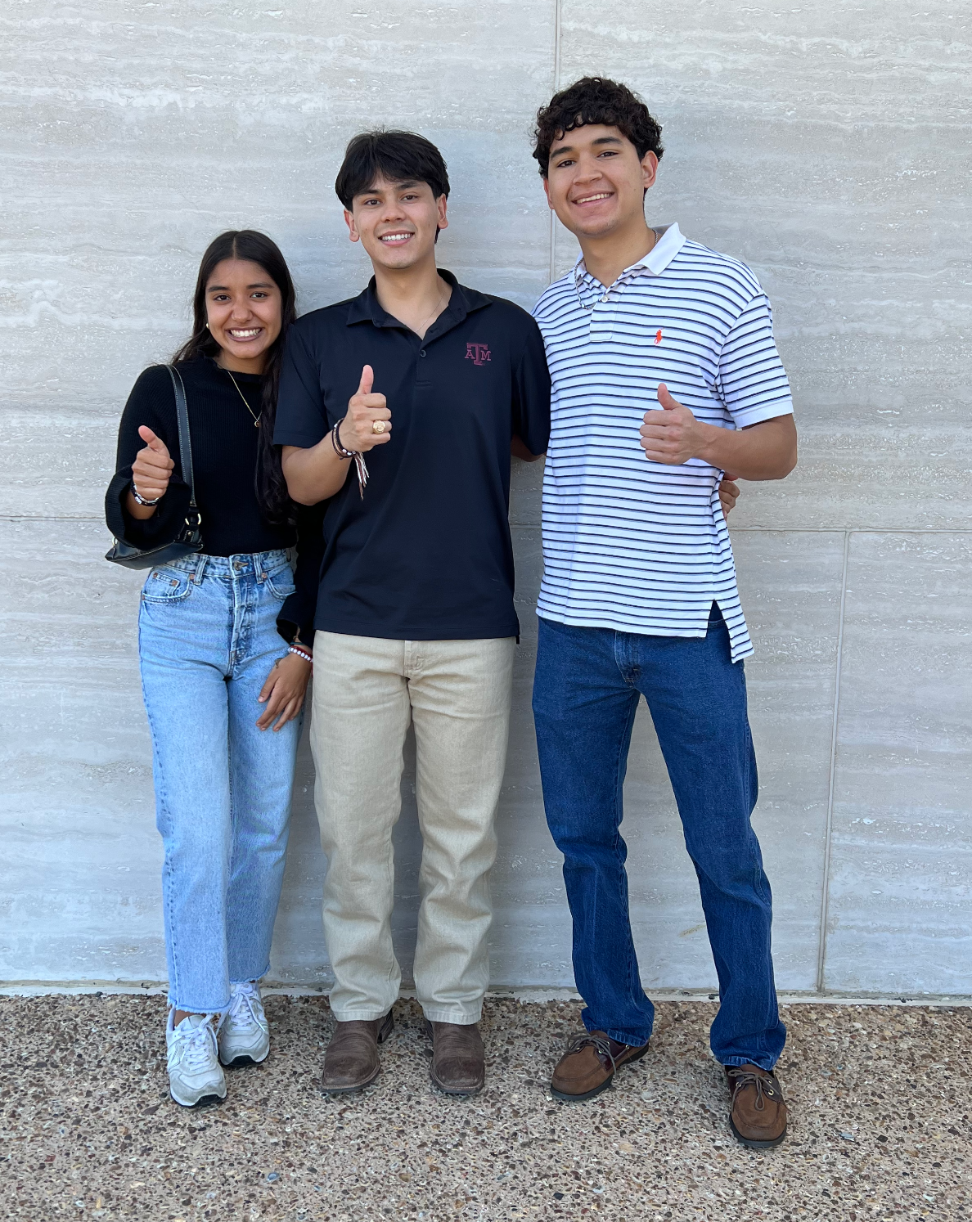
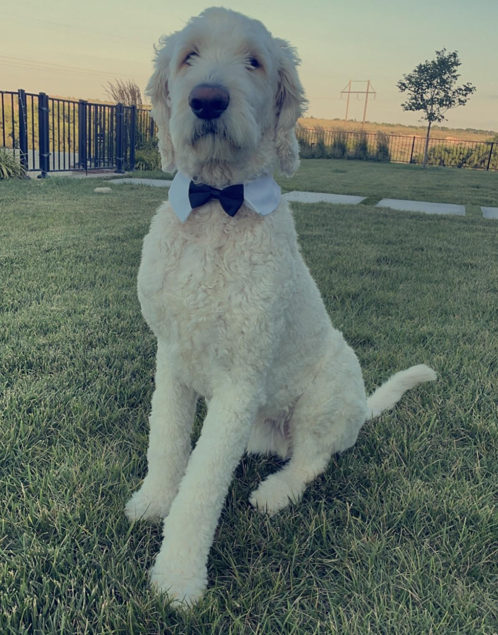
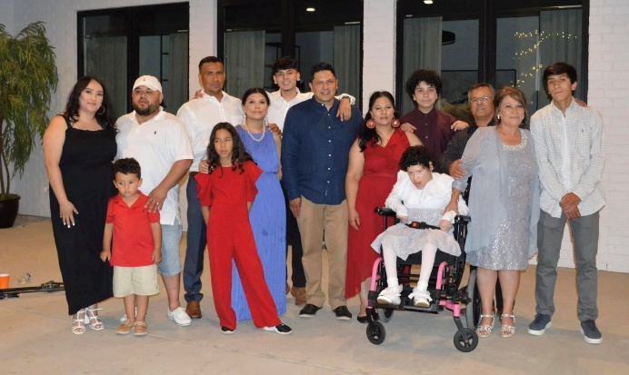
About Me
Hometown - Amarillo, Texas
Texas A&M University
B.S. Electrical Engineering
Graduating Spring 2025
Process Control Engineer Intern
Mentor – Jordan Byars
Supervisor – Slater Ebeling
Interests
Playing guitar
Training my dog
Running
Joaquin Salas
7/16/2024

Slide 4
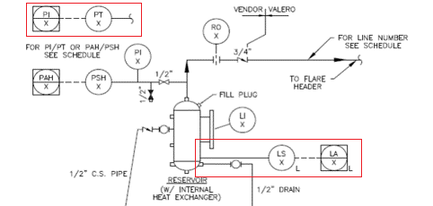
Add Seal Pot Inst. to 730-P101A/B
Problem Statement: No instrumentation to alert operators to potential seal problems.
Proposed Solution: Add Seal Pot Instrumentation to both IC8 Reactor Recycle Pumps to alert Operators of potential seal issues.
Adding Pressure Transmitter and Level Switch.
Show readings in DCS.
Seal Pot P&ID
Name
Date Presenting
Summary/Important Comment Tile

Slide 5
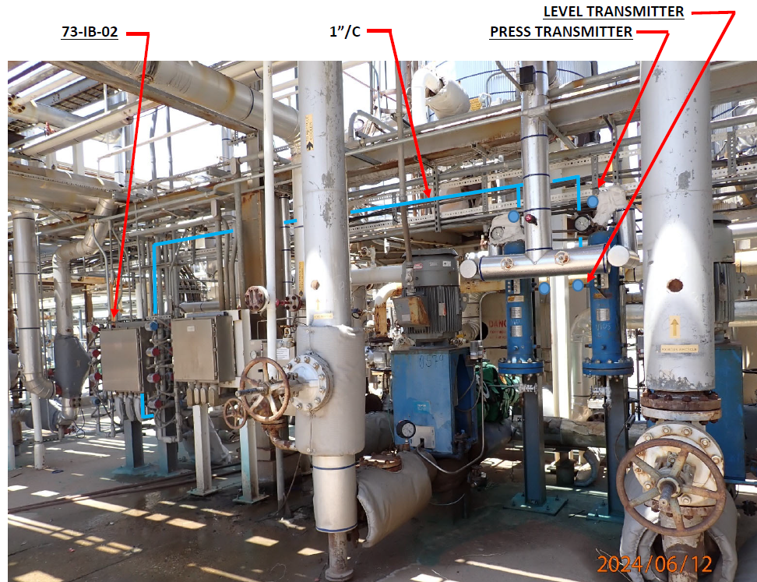
Add Seal Pot Inst. to 730-P101A/B
Contribution:
Specifying Instrumentation
IFA/IFC
MOC
Takeaways:
Knowledge of Seal Pots
Problem Statement to Completion
MOC
Name
Date Presenting
Summary/Important Comment Tile

Slide 6
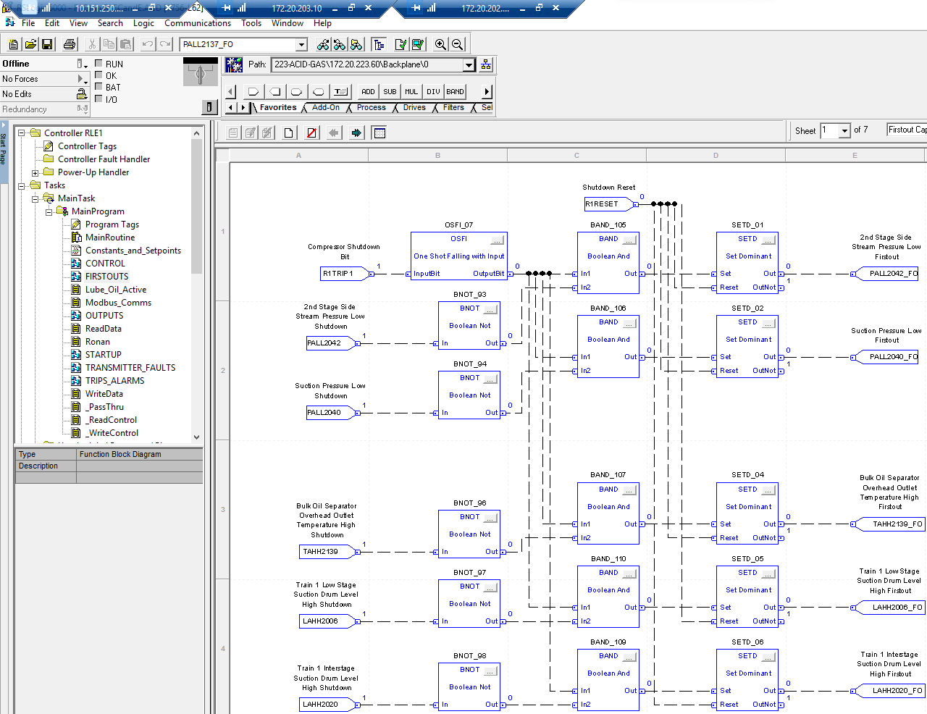
RLE Compressors Cause & Effect
Purpose:
To visually map out and document the relationships between triggers (causes) and their effects on system operations.
Takeaways:
Name
Date Presenting
Summary/Important Comment Tile

Slide 7
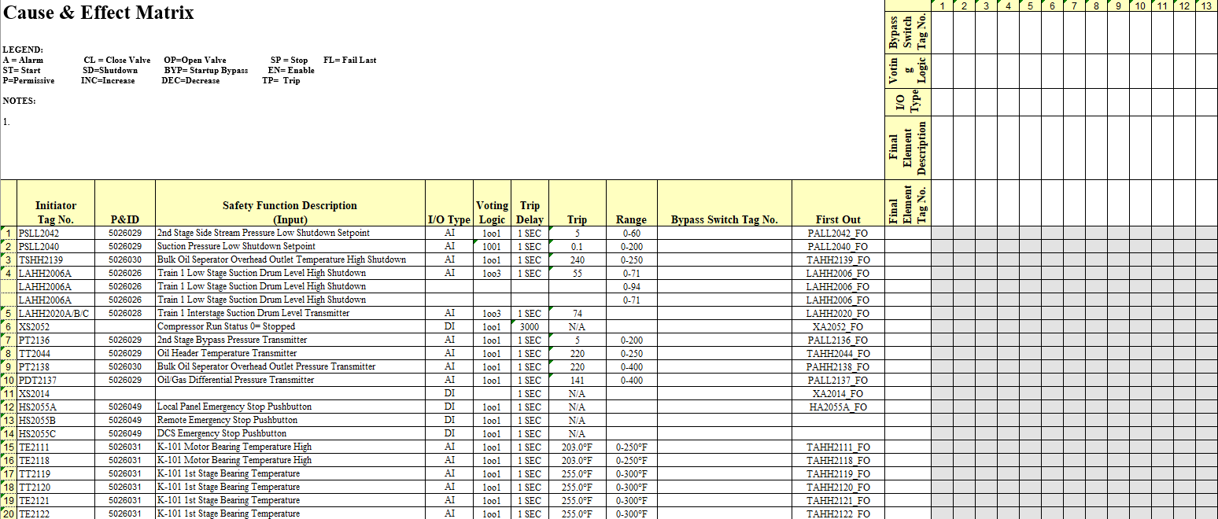
RLE Compressors Cause & Effect
Moving Forward:
Cause & Effect
Name
Date Presenting
Summary/Important Comment Tile

Slide 8
Install Specific Gravity and pH Meters
Name
Date Presenting

Slide 9
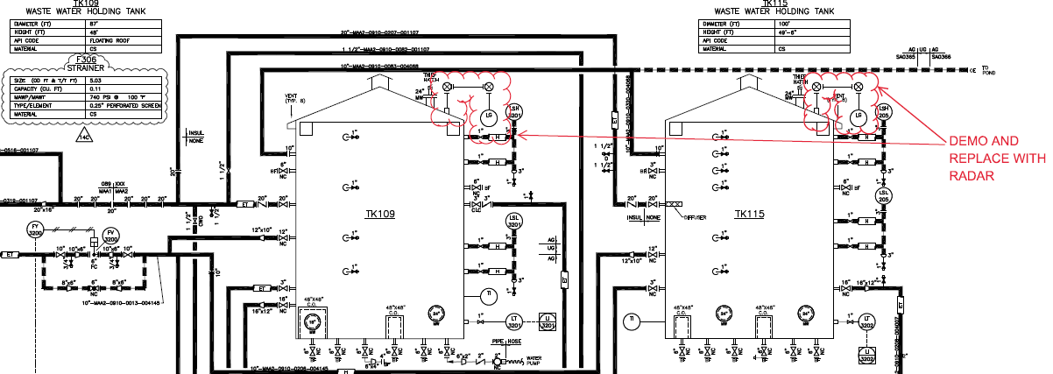
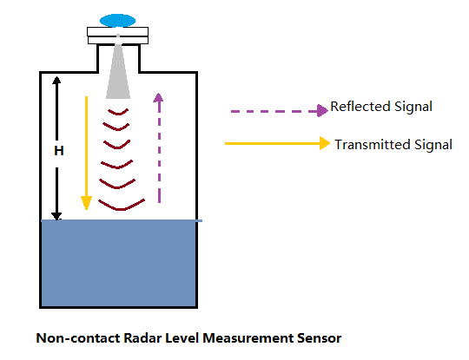
Radar Gauge 910-TK109/115
Problem Statement: Reliability issues with tanks using d/p instruments.
Proposed Solution: Replace or add to the tanks d/p cell level with alternative level instruments.
Replace existing level gauge with radar
Non-contact measurement
Accuracy - not affected by density changes in process conditions.
Redlined P&ID
Name
Date Presenting
Summary/Important Comment Tile

Slide 10
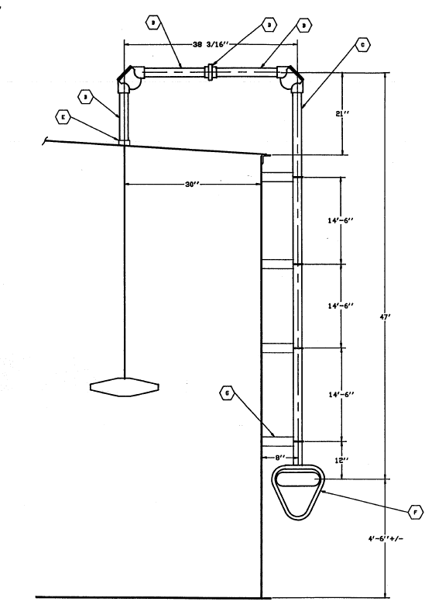
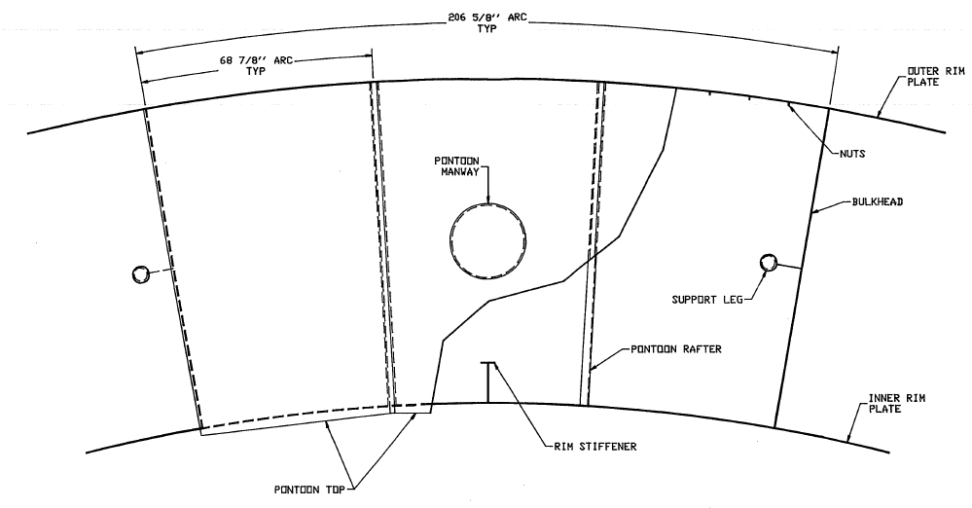
Radar Gauge 910-TK109/115
Contributions:
Found tie in point that does not require new welds
Submitted DWR
Takeaways:
Radar Level Transmitter (Vega)
Floating Roof Tanks
Name
Date Presenting
Summary/Important Comment Tile

Slide 11
Control Valves for TKs 109/115
Problem Statement: Valves are not easily accessible in wet and muddy conditions.
Proposed Solution: Replace with chopper valves so the valves may be opened/closed from the control room.
Evaluated cost-effective solutions.
Confirm availability of instrument air.
Coordinate with Operations, Process, and Vendors.
Takeaways: Cost Analysis, Chopper Valves
Outcome: Awaiting design package
Name
Date Presenting
Summary/Important Comment Tile

Slide 12
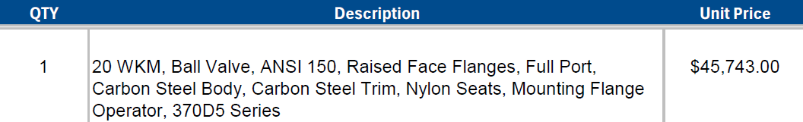
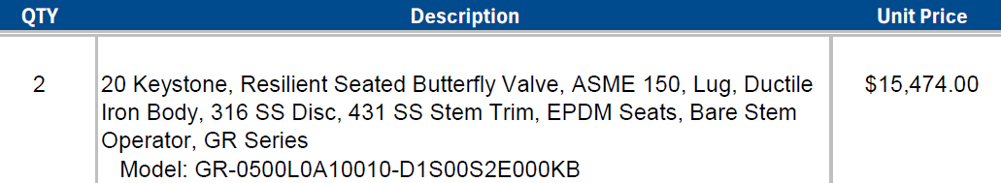
Control Valves for TKs 109/115
Option 1: Ball Valve
~ $50,000 + Installation
Quarter Turn Valve
Option 2: Butterfly Valve
~ $15,000 + Installation
Quarter Turn Valve
Name
Date Presenting
Summary/Important Comment Tile

Slide 13
Control Valves for TKs 109/115
 | Ball Valve | Butterfly Valve
Material | Carbon Steel | Ductile Iron
Turn Radius | Quarter turn | Quarter turn
Mechanical Change Required | No | Yes
Cost | $50,000 | $15,000
Name
Date Presenting
Summary/Important Comment Tile

Slide 14
More Projects
#2 Amine Still Feed Instrumentation
Sulphur experts conducted an amine system evaluation.
Recommendation to install Temperature Transmitter downstream of E-109/110/111.
Awaiting Design Package.
Mag Tech for NC4 Contactor
Existing sight glasses are stained, can not read level.
Replace with Mag Tech.
Working with Emerson on Quote.
Replace RSW LEL Monitors
Existing LEL monitors are obsolete and down to two warehouse spares.
Replace existing U9500 CAT BEAD detectors with Draeger Polytron 8700.
Completed MOC and EWR Closure.
Pressure Indication 820-TK5802
Low alarm set at 2 psig to ensure nitrogen blanket is adequate to prevent oxygen ingress.
Received Design Package.
Name
Date Presenting
Summary/Important Comment Tile

Slide 15
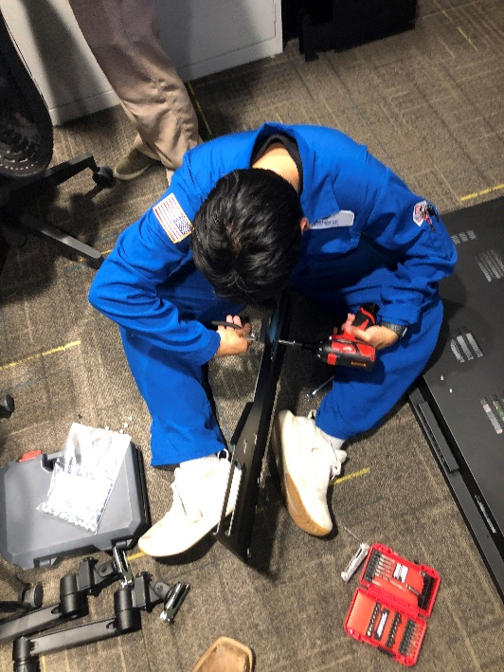
Miscellaneous
Splicing, testing, and labeling fiber optics.
Help Jordan install and configure SEL RTAC for wind turbine farm.
Replace monitors/TV screens for operators.
Helping Matt
Working with Kaityln on Wireless pump monitoring
Name
Date Presenting
Summary/Important Comment Tile

Slide 16
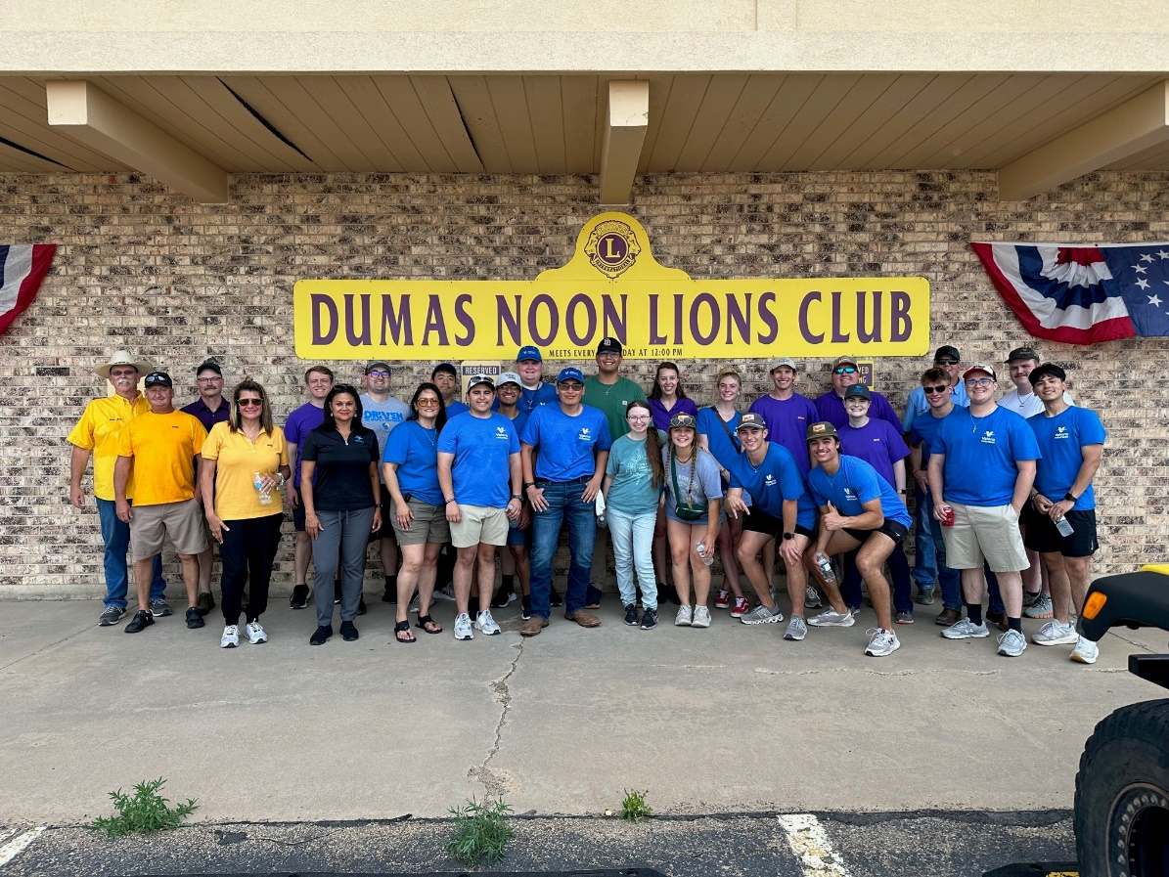
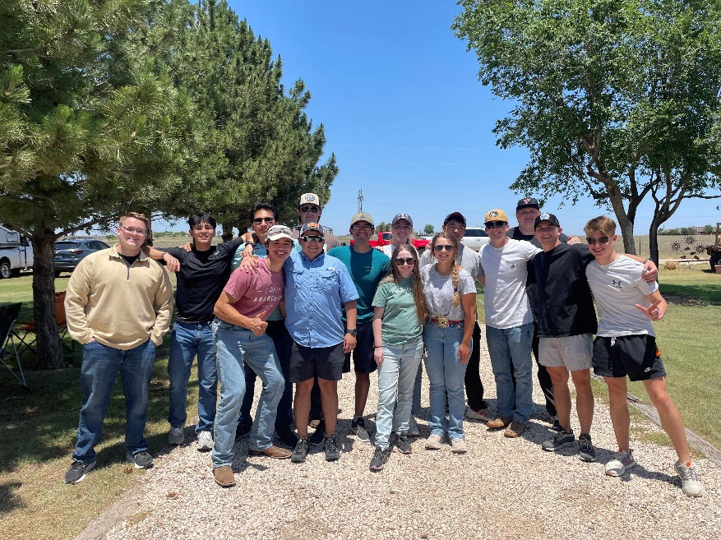
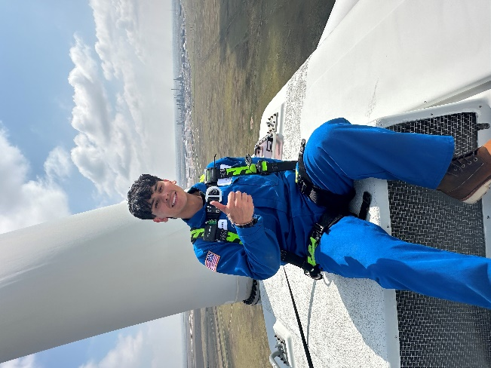
Intern Experience
Volunteering:
Highway Trash Pickup
Corn/Fry Booth
Meat Wrapping
Meals on Wheels
Other:
Clay Shoot
Dogie Days
Windturbine Climb
Intern Symposium
Sod Poodles Game
Dinner with Controls Group
Name
Date Presenting
Summary/Important Comment Tile

Slide 17



Thank You!
Go back to school at Texas A&M
2 Semesters until graduation
Available for full-time job opportunities
Questions?
Name
Date Presenting

